Slide 1


SOMPA WP5

Slide 2
Scientific papers in pipeliene
Lehtonen et al.: Continuous cover forestry (CCF) for drained peatlands – impacts to emissions and harvesting (Draft, results are ready)
Eyvindson et al. Quantifying forest management impacts on GHG emissions from drained peatland forests: Balancing production and climate goals (Draft)
Haakana et al. Carbon stock changes for tree biomass in Finland (Almost ready to be submitted)

Slide 3

Continuous cover forestry (CCF) for drained peatlands – impacts to emissions and harvesting
PRELIMINARY RESULTS
Aleksi Lehtonen, Kari Härkönen, Kyle Eyvindson, Mikko Peltoniemi, Raisa Mäkipää, et al.

Slide 4

Background
Drained peat exchange GHGs depending
  Primarily: Site type, ditch spacing, ditch depth, living biomass and weather
The emissions can be modified through management (changing ditch depth and transpiring biomass)
  These will change the ground water table – changing the ability of the peat to emit GHGs

Slide 5
Background
Forest management affects living biomass and ditch depth
  How can we mitigate GHG emissions from drained peatlands
If we need to use these sites for production purposes, how should we?
Forest simulations can inform of the possible trade-offs between production and GHG emissions

Slide 6
How to project forest growth
Use a forest simulator, here MELA
Input data:
  Latest forest inventory data
Define scenarios and then project future development over time.
Connect these projections to a modelling framework that estimates GHG emissions

Slide 7
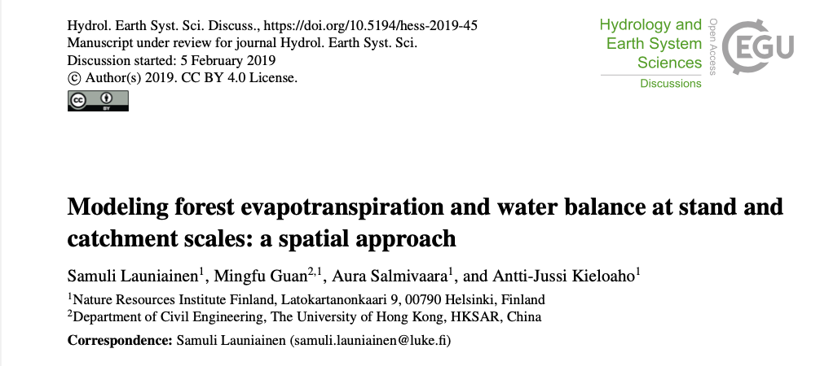
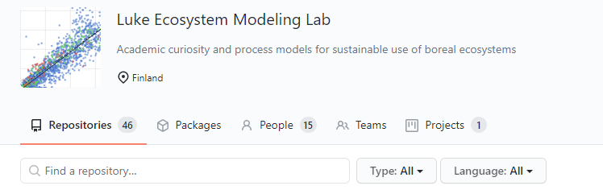
How to model GWT of drained peats
Link forest modelling data to SpaFHyPeat (Launiainen et al. 2019)
Input data required (9 elements):
  Canopy fraction, Dominant tree Height, LAI of Pine, Spruce and Deciduous trees, Soil fertility, ditch spacing and depth, and weather data.

Slide 8
Modelling ditch depth
Inclusion of variable ditch depth – (Hökkä et al. 2020)
  Quality of ditch changes over time
Model is based on:
  Ditch age
  Ditch construction
  Peat thickness
  Peat slope
Some variables are known, others can be estimated

Slide 9
Soil emission estimation
Understory LAI: 0.5 when basal area (G) less than 0.5 m², 1.5 when G > 0.5 & < 5, thereafter decreasing trend until G = 30 (treated as deciduous)
N₂O & CO₂ after clear felling (Korkiakoski + Mäkiranta):
  > Vaccinimiun: 4 to 1 g N₂O per m² linear decrease, first 10 years
  < Myrtillus: 1 to 0.2 g N₂O per m² linear decrease, first 5 years
  > Vaccinimiun: from 2700 g CO₂ per m² linear decrease, first 9 years
  < Myrtillus: 2000 g CO₂ per m² linear decrease, first 9 years
  Thereafter according to Minkkinen et al. 2020 & Ojanen et al. 2019
Ditch CH₄ (kg /ha) as function of depth (cm) e <- d/( 3.319830 + 0.009518 * d)
Distance between ditches based segmented forest and ditch network analysis

Slide 10
Soil emission estimation II
  Drained peatlands: natural mortality and harvest residues based on Yasso07 simulations
  Upland soils: all litterfall based on Yasso07 simulations

Slide 11
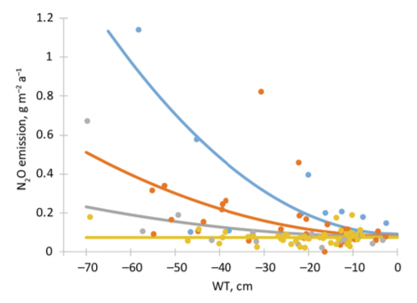
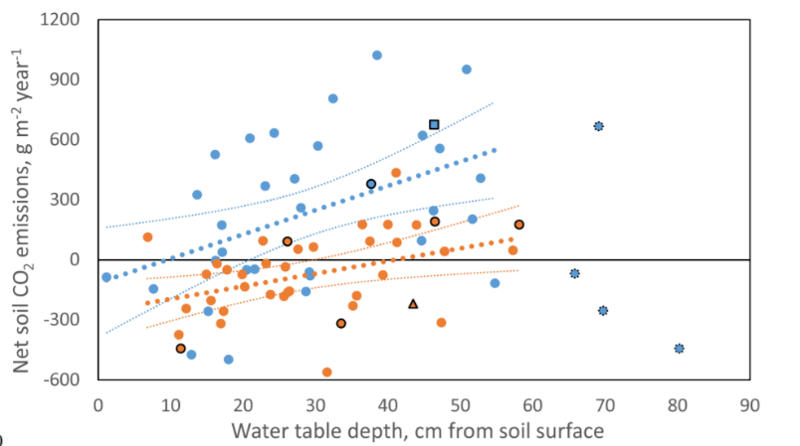
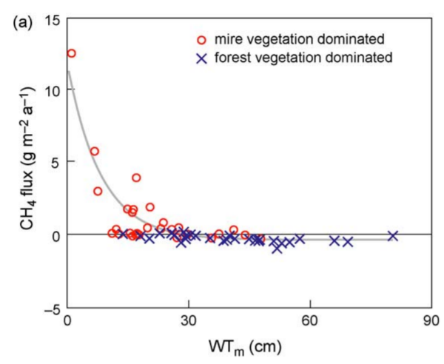
Modelling GHG emissions
Emissions from drained peat linked to ground water table & fertility:
N₂O – Minkkinen et al. (2020).
CO₂ – Ojanen and Minkkinen (2019)
CH₄ – Ojanen et al. (2010)

Slide 12
Scenarios I
Defining soil management
  BAU
    Management of drained peatlands as it has been, ditching after clearfelling and based on MELA (without subsidies)
  SOMPA
    Compulsory CCF with spruce dominated stands on fertile soils (>Vaccinium type). Nutrient poor sites: ditching as in BAU
  JURO (as a sensitivity analysis)
    Same as SOMPA, but first 5 years of growth of suppressed trees reduced by 25%

Slide 13
Scenarios II
Defining level of loggings (demand)
Maximum sustained
  BAU
  SOMPA
  JURO
Actual fellings (2016-2018)
  BAU
  SOMPA
  JURO

Slide 14
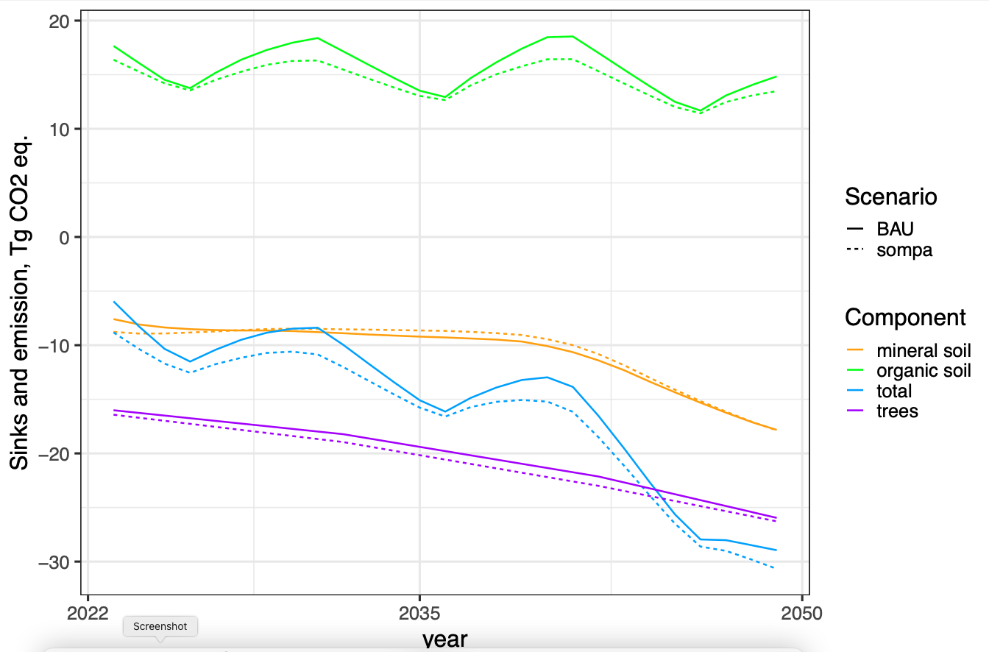
Preliminary results

Slide 15
References:
Hökkä, H., Stenberg, L. & Laurén, A. (2020) Modelling depth of drainage ditches in forested peatlands of Finland. Baltic Forestry. 26(2): 453.
Launiainen, S., Guan, M., Salmivaara, A. and Kieloaho, A.J., 2019. Modeling boreal forest evapotranspiration and water balance at stand and catchment scales: a spatial approach. Hydrology and Earth System Sciences, 23(8), pp.3457-3480.
Minkkinen, K., Ojanen, P., Koskinen, M., & Penttilä, T. (2020). Nitrous oxide emissions of undrained, forestry-drained, and rewetted boreal peatlands. Forest Ecology and Management, 478, 118494.
Ojanen, P., Minkkinen, K., Alm, J., & Penttilä, T. (2010). Soil–atmosphere CO2, CH4 and N2O fluxes in boreal forestry-drained peatlands. Forest Ecology and Management, 260(3), 411-421.
Ojanen, P., & Minkkinen, K. (2019). The dependence of net soil CO2 emissions on water table depth in boreal peatlands drained for forestry. Mires and Peat, 24(27), 1-8.

