Slide 1
Lukeloki Solution for Food Services, Household FW Study
17.7.2023
Kirsi Silvennoinen, Sampsa Nisonen

Slide 2
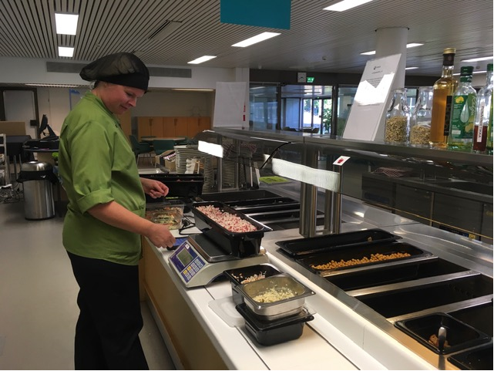
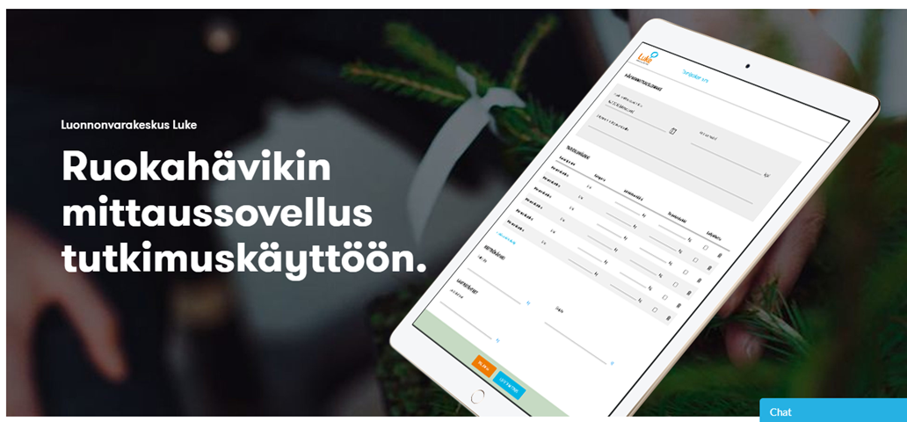
Luke has developed an online application Lukeloki for measuring food waste (FW) in food service companies
When monitoring FW companies get up to date information on reaching their goals and can make decisions on how to reduce FW. At the same time Luke will get data for research porposes.
The application can be used with phone, tablet or computer by kitchen personnel. Food waste is logged in daily to the application by origin, and it is separated to kitchen waste, serving waste and customer plate leftovers.
https://projects.luke.fi/ravintolafoorumi/lukeloki-2/

Slide 3
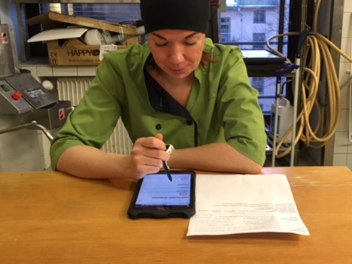
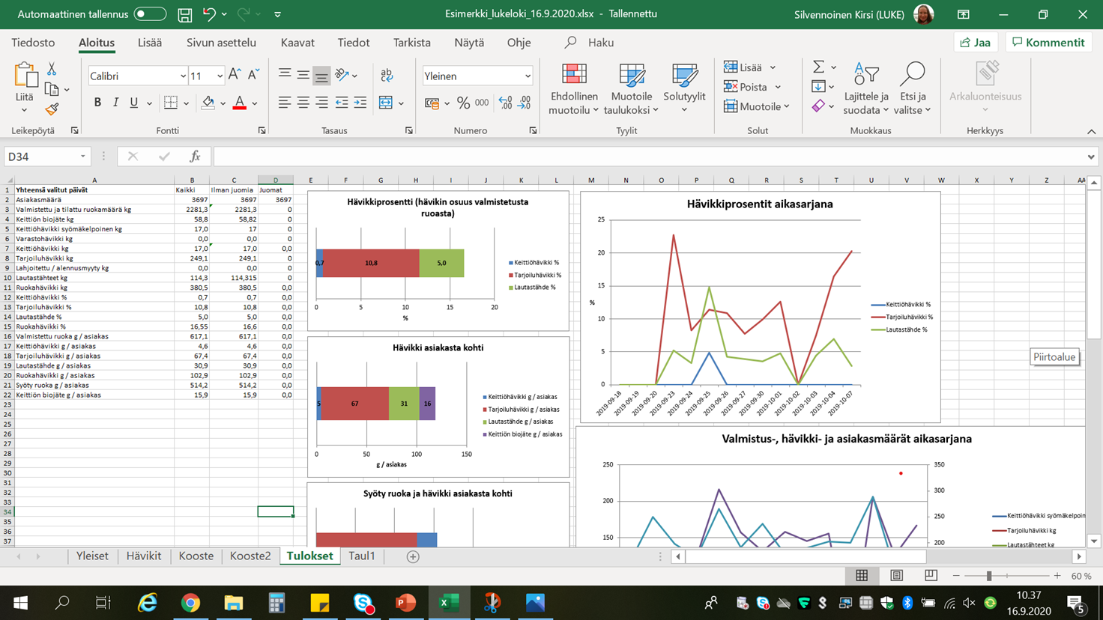
Simple and easy
To make daily measuring and logging easy, menus are imported to the application in advance. The monitoring system can be used in either buffet or a la carte restaurants and in outlets with both options.
The application calculates both FW (originally edible and inedible) per kilogram of prepared food and FW per customer. The results can be used to evaluate what are the most significant sources of FW and what are the underlying reasons for it.
https://www.materiaalitkiertoon.fi/fi-FI/Circwaste

Slide 4
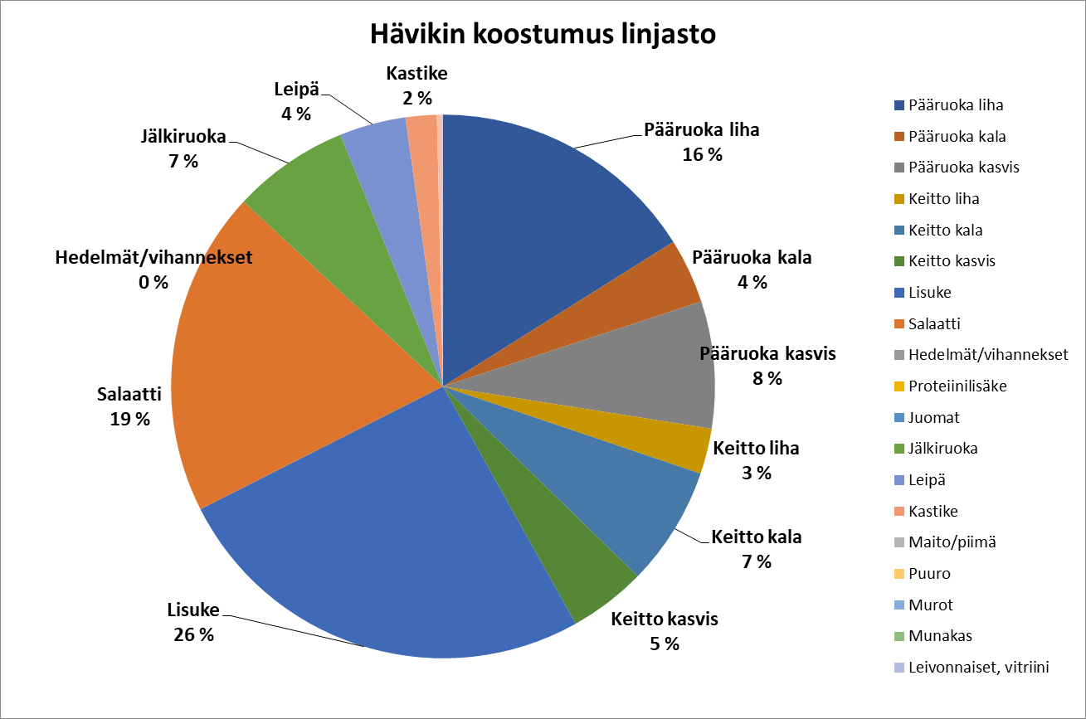
Results graph examples

Slide 5
Results from Food Services in Finland 2019
Silvennoinen, K., Nisonen, S. ja Lahti, L. 2019. Ravitsemispalveluiden elintarvikejäte : jätteen määrä 2018–2019 ja seurannan kehittäminen. Luonnonvara- ja biotalouden tutkimus 1/2020. Luonnonvarakeskus. Helsinki. 45 s.

Slide 6
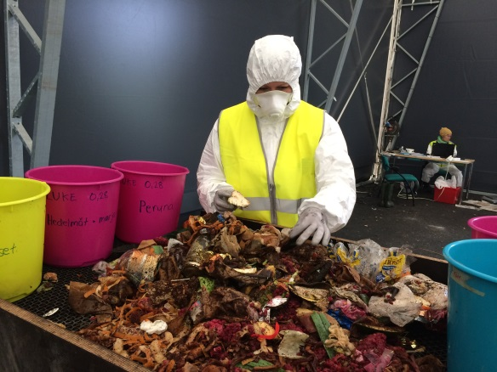
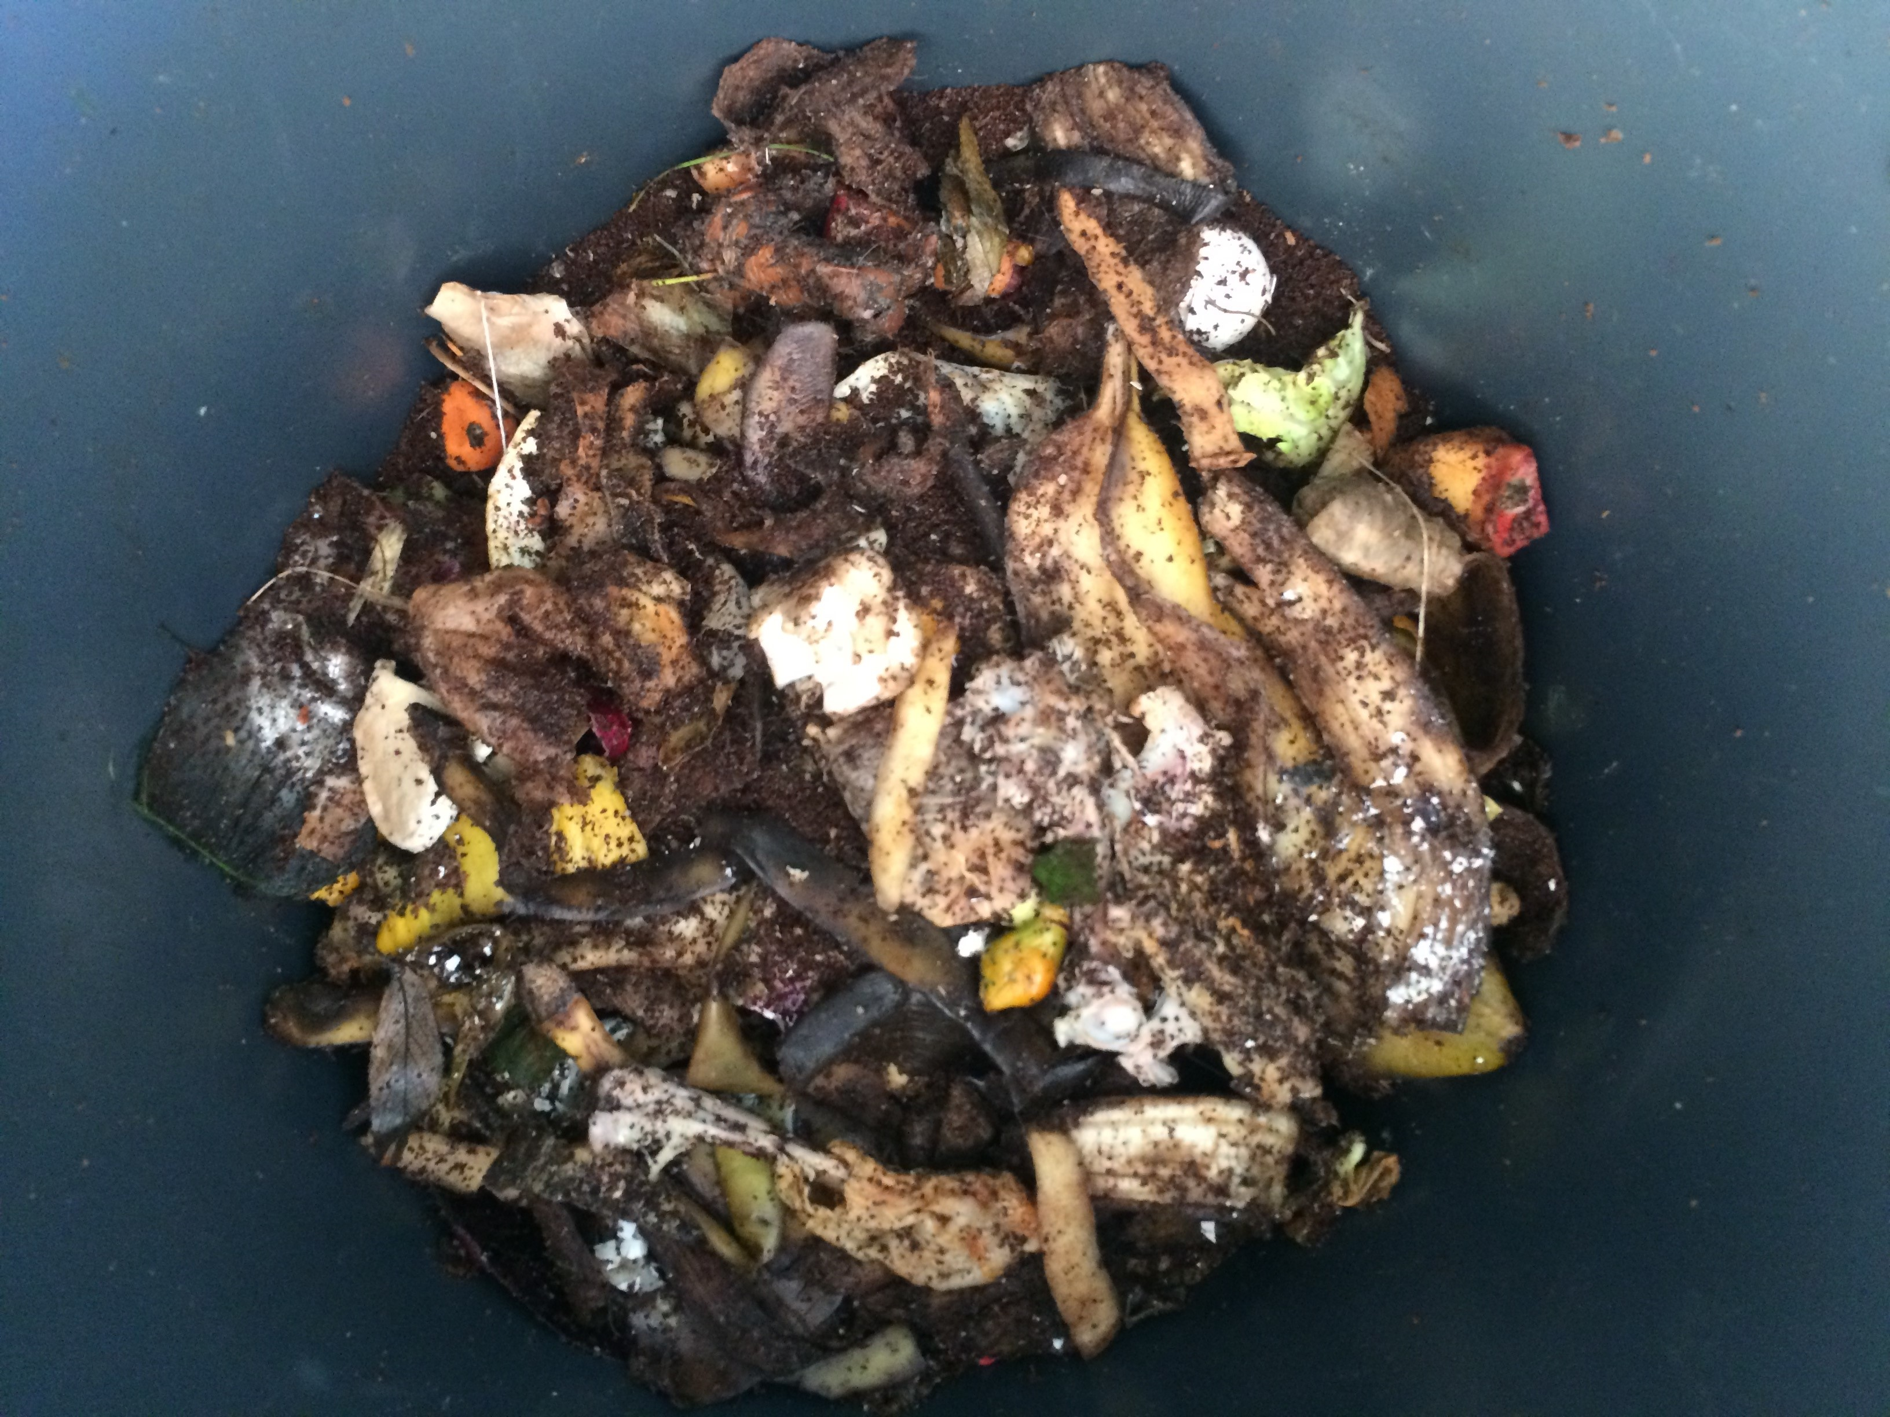
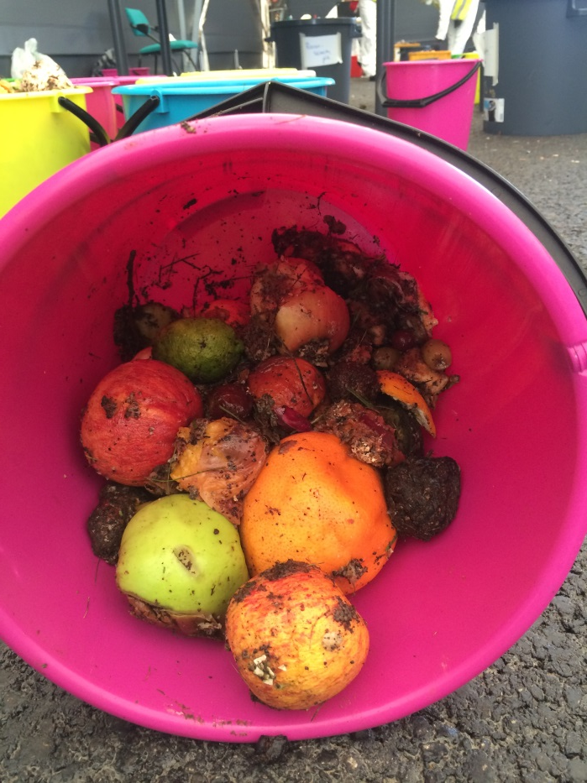
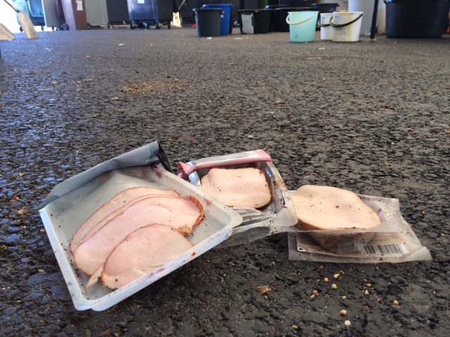
Food Waste Amount, Type and Climate Impact in Urban and Suburban Areas in Finnish Households
S
STUDY REGIONS
METHOD: Waste composition analysis
RESULTS
Mixed Waste/Separately Collected Biowaste
Food Waste (FW)
Originally Inedible FW
Originally Edible FW
FW 53.0–62.1 kg/cap/y
Edible FW 23.0–28.4 kg/cap/y
Climate impact CO2-ekv 51.9–61.4 kg/cap/y
Most wasted food: fruit and vegetables, other products
including homecooked food, bread
Climate impact dominated by meat and fish, 36–45% of total
Cooperation with waste management companies supports resource efficiency
Helsinki 2015
Tampere 2016
Helsinki 2018
Turku 2019
Kirsi Silvennoinen, Sampsa Nisonen, Juha-Matti Katajajuuri.
Journal of Cleaner Production, Volume 378, 2022,
https://doi.org/10.1016/j.jclepro.2022.134430.

Slide 7
Some scientific articles:
Silvennoinen, Kirsi; Nisonen, Sampsa; Katajajuuri, Juha-Matti. 2022. Food waste amount, type, and climate impact in urban and suburban regions in Finnish households. Journal of Cleaner Production 378: 8 p.
Silvennoinen, Kirsi; Nisonen, Sampsa; Pietiläinen, Oona. 2020. Food Waste in the Service Sector: Key concepts, measurement methods and best practices. In: Routledge Handbook of Food Waste. Routledge. 144-156.
Nisonen, Sampsa; Silvennoinen, Kirsi. 2020. Food waste in food services. In: Preventing food losses and waste to achieve food security and sustainability. Burleigh Dodds Series in Agricultural Science: 367-382.
Silvennoinen, Kirsi; Nisonen, Sampsa; Pietiläinen, Oona. 2019. Food waste case study and monitoring developing in Finnish food services. Waste Management 97: 97-104.
Heikkilä, Lotta; Reinikainen, Anu; Katajajuuri, Juha-Matti; Silvennoinen, Kirsi; Hartikainen, Hanna. 2016. Elements affecting food waste in the food service sector. Waste Management 56: 446-453.
Silvennoinen, Kirsi; Heikkilä, Lotta; Katajajuuri, Juha-Matti; Reinikainen, Anu. 2015. Food waste volume and origin: Case studies in the Finnish food service sector. Waste Management 46: 140-145.

Slide 8
Thank you!

Slide 9
Luke in brief
Vision
A sustainable future and well-being from renewable natural resources
Mission
Through
research,
we create
value and solutions
for our customers by solving local and global challenges
22
locations
Profitable and responsible primary production
1337
employees
Circular bioeconomy
Adaptive and resilient bioeconomy
Competent
personnel and
motivating
organisation
CO₂
Modern
research
platforms
133 M€
Data-driven
solutions
N₂O
CH₄
Inter-
disciplinarity
and inter-
sectorality
Climate
smart carbon cycle
turnover

Slide 10
You can find us online
luke.fi
Subscribe to our newsletter to stay informed!
luke.fi/newsletter
Natural Resources Institute Finland (Luke)
Latokartanonkaari 9, FI-00790 Helsinki

