Slide 1
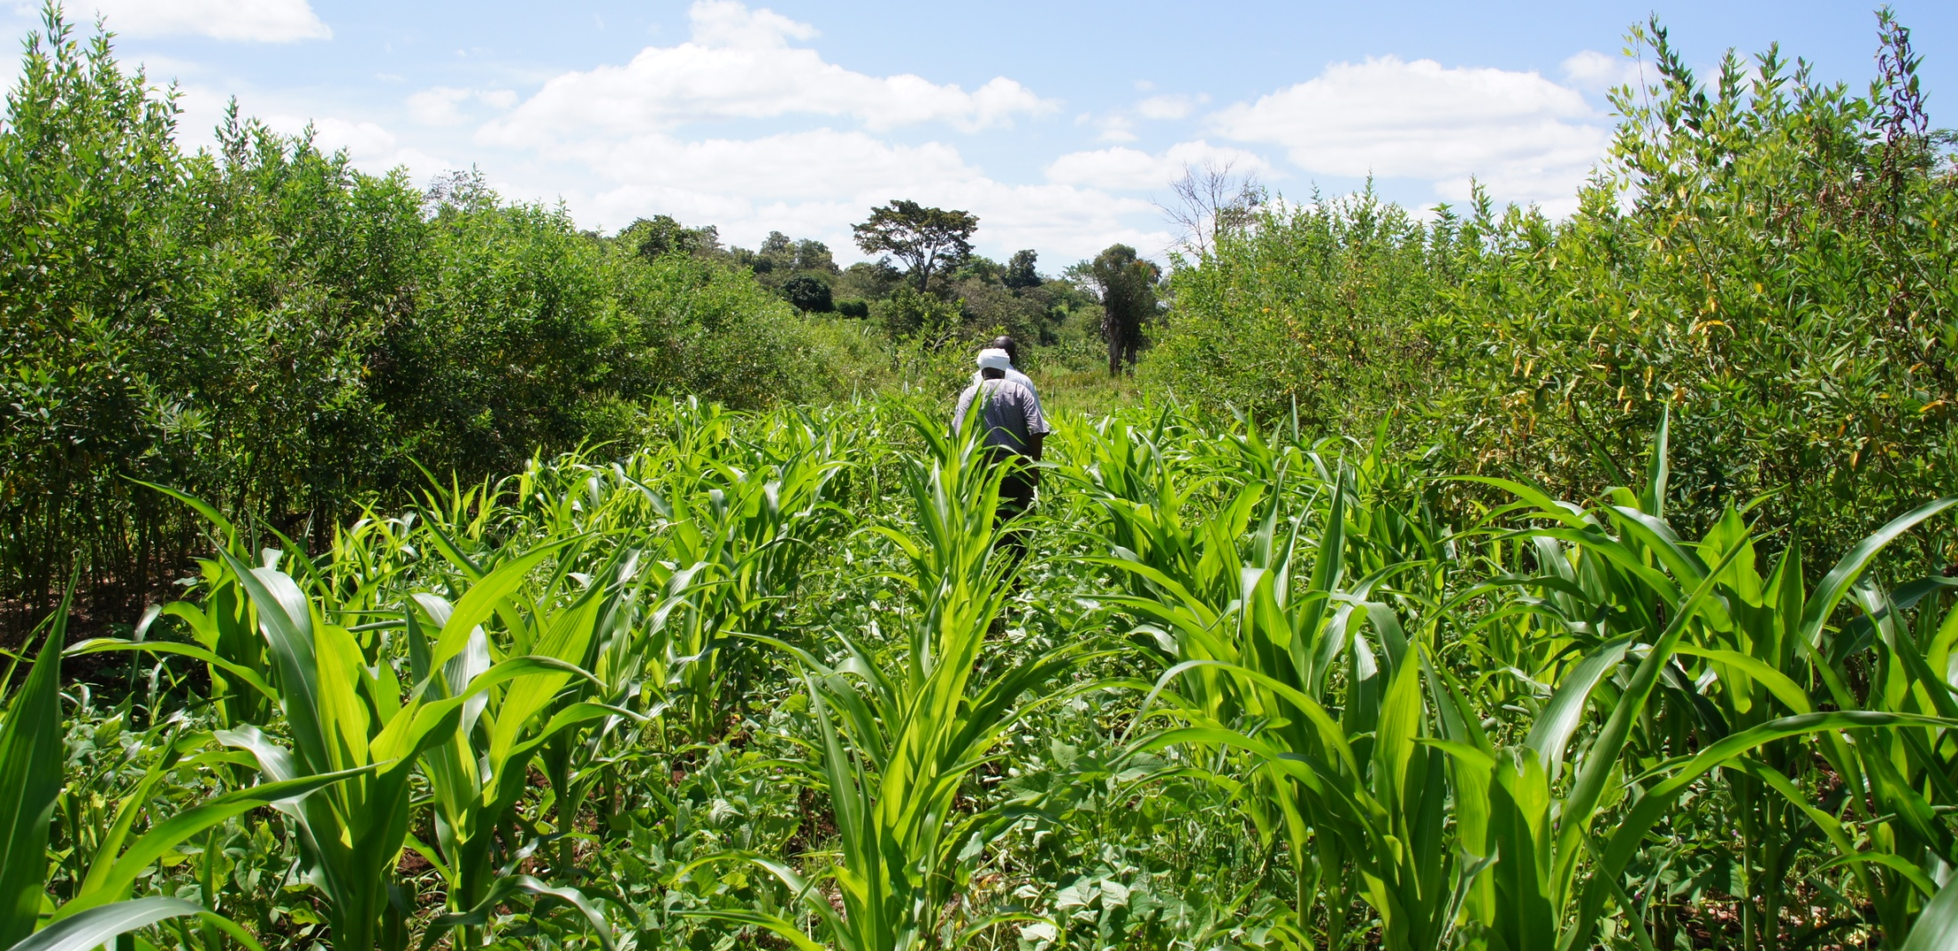
FoodAfrica Research for Development Programme Improving Food Security in West and East Africa through Capacity Building and Information Dissemination

Slide 2
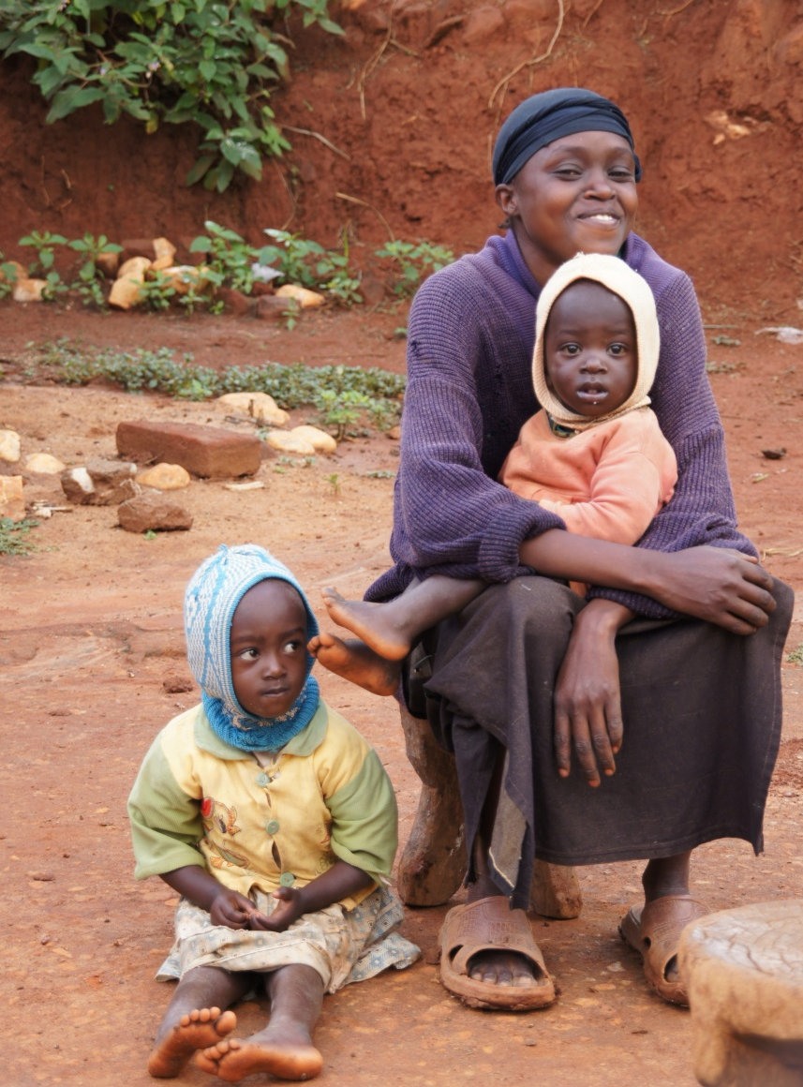
FoodAfrica Programme
A four-year (2012–2016) Research for Development Programme coordinated by Natural Resources Institute Finland (Luke).
The programme budget is 11,8 million €, of which 9,5 million is Official Development Aid from the Ministry for Foreign Affairs of Finland.
FoodAfrica pilots a new model of co-operation between eight partners: Luke, IFPRI, ICRAF, ILRI, Bioversity International, University of Helsinki, HAMK and the Ministry for Foreign Affairs of Finland.
The programme consists of seven Work Packages
Six African countries are involved in the programme: Benin, Cameroon, Ghana, Kenya, Senegal and Uganda.

Slide 3
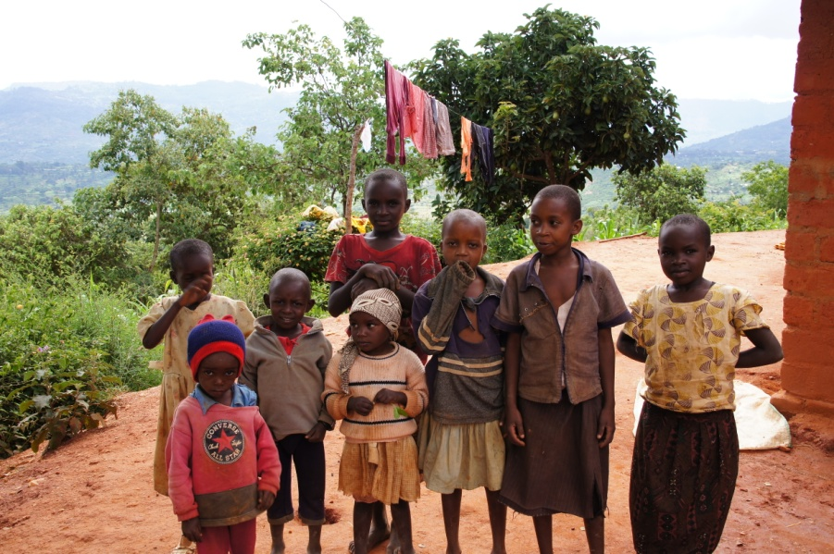
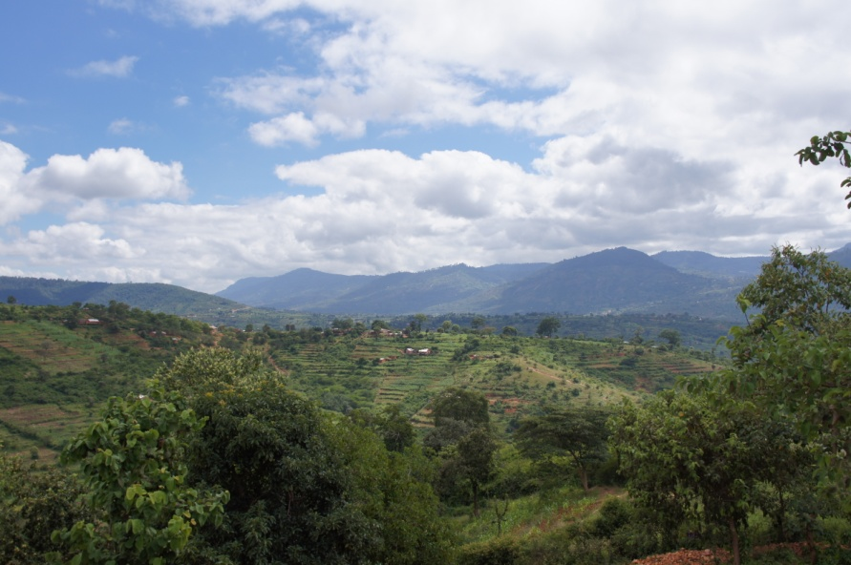
Programme Objectives
To strengthen education and research capacity of the local agricultural sector in East and West Africa, in terms of production, market performance and nutrition, in order to reduce poverty and improve food security in the region.
To produce new, scientific evidence for improving nutrition and food security in Africa.
To enhance cooperation between researchers and research and educational institutions in the region.
To enhance knowledge dissemination between local African and Finnish experts, and experts in the CGIAR centres.
To produce concrete guidelines for policy recommendations on food security for use by local institutions and authorities

Slide 4
FoodAfrica Work Packages and Partners
WP1
Soil micronutrients (Sub-Saharan Africa)
ICRAF, University of Nairobi, Luke
WP2
Sustainable dairy production (Senegal)
ILRI, EISMV, University of Helsinki, Luke
WP3
Agricultural practices in a changing climate (Senegal)
IFPRI, ISRA, Luke
WP4
Traditional foods for nutrition (Benin)
Bioversity International, University of Benin, University of Helsinki
WP5
Reducing risk of mycotoxins (Kenya)
ILRI, IFPRI, University of Nairobi, Luke
WP6
Better market access through ICT’s (Ghana & Uganda)
IFPRI, Luke
WP7
Innovative extension approaches (Kenya & Cameroon)
ICRAF, HAMK

Slide 5
Cross-Cutting Objectives and Joint Activities
The seven Work Packages have a common Dissemination Strategy
Human Rights based approach in all Work Packages
Integration of cross-cutting objectives of Finnish Development policy in all Work Packages
Climate Sustainability
Gender Equality
Reduction of Inequality

Slide 6
WP 1: Strengthening capacity for diagnosis and management of soil micronutrient deficiencies in Sub-Saharan African countries for improved plant, animal and human nutrition
Objectives
To strengthen African capacity to diagnose and manage soil micronutrient deficiencies for improved food production and human health.
To increase food productivity and quality and human nutrition through improved soil micronutrient diagnostics and management in Sub-Saharan Africa.
To enable better targeting and monitoring of interventions aimed at improving crop, livestock and human health at different levels, from farm to international development policy.
Partners
ICRAF
Luke
University of Nairobi, Institute of Nuclear Physics

Slide 7
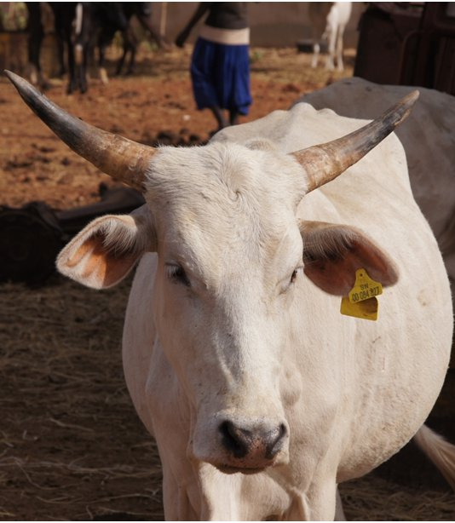
WP 2: Improved food and nutritional security from better utilisation of dairy cattle breed types in Senegal
Objectives
To identify and promote utilization of the most appropriate dairy breed and cross-breed types through characterisation of germplasm for more productive and profitable dairy enterprises in selected production systems in Senegal.
Partners
ILRI
Luke
University of Helsinki, Department of Agricultural Sciences
National Research Institute in Senegal

Slide 8
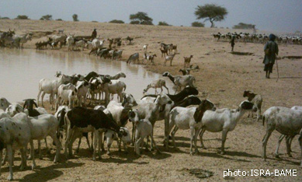
WP 3: Economic analysis on technologies and targeted policies to reduce vulnerability and building resilience in Senegal
Objectives
To build resilience within the agricultural sector of Senegal in the face of climate risk.
To enhance the adaptive capacity of the wider Senegalese economy in order to secure livelihoods and welfare and to reduce vulnerability to environmental and socio-economic shocks.
Partners
IFPRI
Luke
ISRA (national research institute in Senegal)

Slide 9
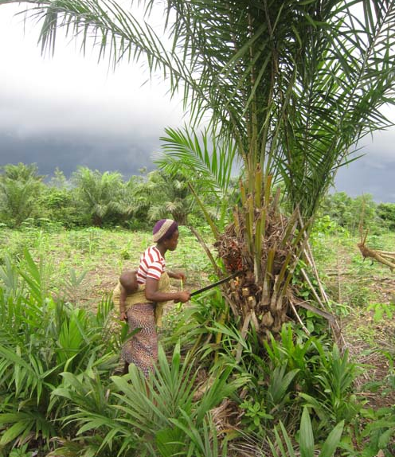
WP 4: Enhancing food and nutrition security of vulnerable groups in communities in Benin through increased use of local agricultural biodiversity
Objectives
To improve household food security, nutrition and health of infants and young children within resource-poor communities in Benin.
To study the diets and nutritional status of infants, young children and mothers in order to identify the determinants of food security in households in target communities.
To identify optimal diets from locally sourced foods and to develop communication strategies to increase demand and supply of foods that meet nutritional, cultural and economic considerations of infants, young children and women.
Partners
Bioversity International
University of Helsinki, Department of Food and Environmental Sciences
Universite d’Abomey Calavi, Benin

Slide 10
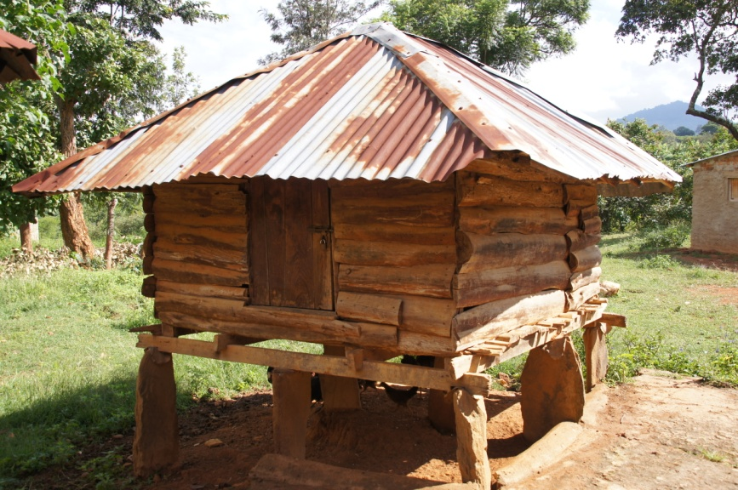
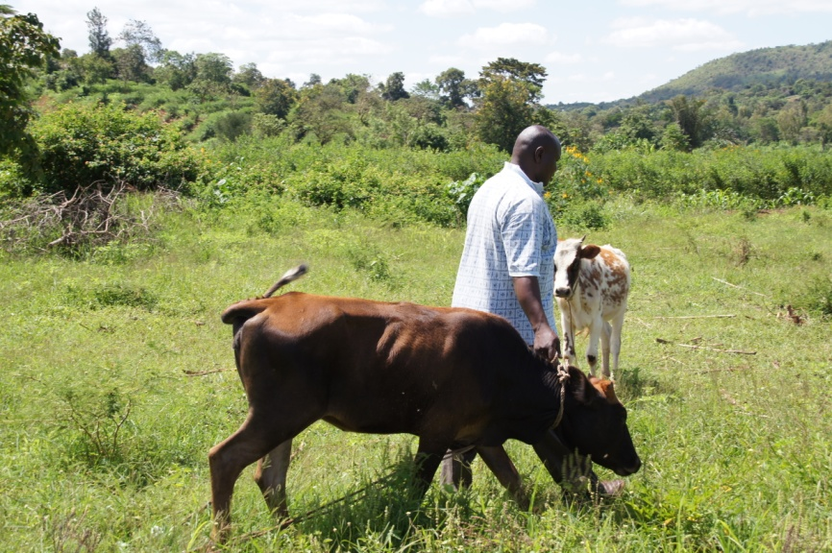
WP 5: Measuring and mitigating the risk of mycotoxins in maize and dairy products for poor consumers in Kenya
Objectives
To strengthen capacity at local and national level for assessing and mitigating mycotoxins in milk and maize.
To improve food safety and human and animal health by reducing mycotoxin contamination in staple crops and dairy products in Kenya.
To improve market access of the poor in Sub-Saharan Africa through improved post-harvest technologies.
Partners
ILRI
IFPRI
Luke
University of Nairobi
ACDI/VOCA

Slide 11
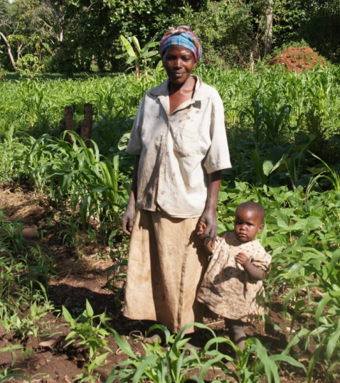
WP 6: Using information and communication technology to improve market access in Africa
Objectives
To reduce poverty and increase food security by improving market access of small-scale farmers.
To identify the best practices in designing and implementing market information systems that maximize pro-poor impact.
Partners
IFPRI
Luke
ISSER (University of Ghana)
FIT-Uganda
Esoko

Slide 12
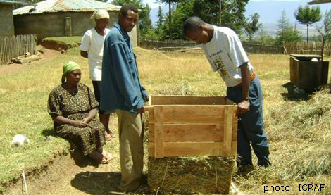
WP 7: Innovative extension approaches for improving food security and livelihoods
Objectives
To improve farmers’ access to new agricultural technology and information in order to improve their livelihoods and food security, with an emphasis on improving access for women and the poor.
To create a framework to support dissemination methods and capacity of all FoodAfrica Work Packages.
Partners
ICRAF
HAMK University of Applied Science
ANAFE

Slide 13
Expected Outcomes
Concrete tools and guidelines for policy makers, small-scale farmers and for their educators
New market and risk management approaches
Agricultural innovations and technologies accessible to the small-scale farmers
Strengthened scientific capacity and networks of African researchers
Strengthened human and institutional capacity

Slide 14
Contact Information
Programme Director
Hannu Korhonen, Luke, hannu.j.korhonen@luke.fi
Programme Coordinator
Mila Sell, Luke, mila.sell@luke.fi
WP1
Keith Shepherd, ICRAF, k.shepherd@cgiar.org
Martti Esala, Luke, martti.esala@luke.fi
WP2
Karen Marshall, ILRI, k.marshall@cgiar.org
Jarmo Juga, University of Helsinki, jarmo.juga@helsinki.fi
WP3
Siwa Msangi, IFPRI, s.msangi@cgiar.org
Jarkko Niemi, Luke, jarkko.niemi@luke.fi
WP4
Bruce Cogill, Bioversity International, b.cogill@cgiar.org
Marja Mutanen, University of Helsinki, marja.mutanen@helsinki.fi
WP5
Delia Grace, ILRI, d.grace@cgiar.org
Hannu Korhonen, Luke, hannu.j.korhonen@luke.fi
WP6
Nick Minot, IFPRI, n.minot@cgiar.org
Jarkko Niemi, Luke, jarkko.niemi@luke.fi
WP7
Steve Franzel, ICRAF, s.franzel@cgiar.org
Eija Laitinen, HAMK, eija.laitinen@hamk.fi

Slide 15
Thank you! www.luke.fi/foodafrica
Photo by Mila Sell /Luke

